Slide 1
Software Engineering and Architecture
Pattern Catalog: Proxy

Slide 2
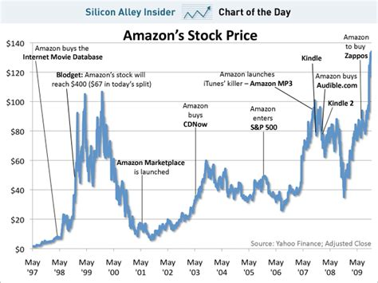

Case
We need to show a graph of stock prices for a company.
We use a paid web service to fetch on-line stock prices
25cent pr request
Interface:

Slide 3
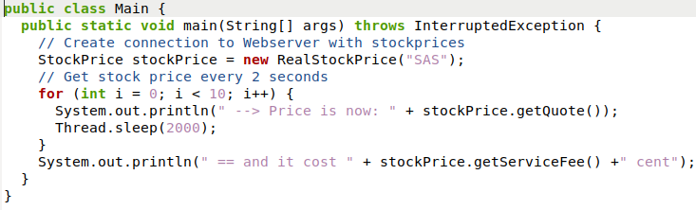
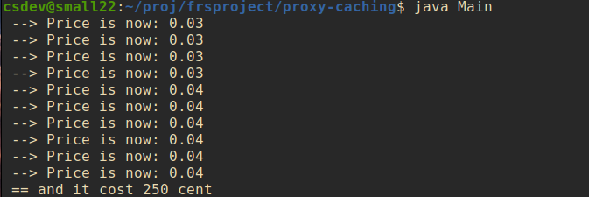
So, we can make a “graph”
No, I did not want to write graph software, so I did a loop
Impl., that connects to service and get the price…
Notes:
META: code in frsproject/proxy-caching

Slide 4
So, we can make a “graph”
No, I did not want to write graph software, so I did a loop:
10 calls to the service each costs 25 cents Total: 250 cents

Slide 5
But…
It is costly to fetch almost the same price over and over again. Why do we not cache it for some period of time?
Caching: Store a local copy of an “expensive-to-get” value, and use that for a specified period of time, to avoid expensive requests…
How does 3-1-2 look?
3: Encapsulate variation: We need to vary the request call – either make it or replace by local copy
1: Program to interface: Insist client only accesses the stock request through an interface
2: Favor composition: Compose behavior by putting an “intermediate”, the proxy, that will do a real fetch after some time limit.

Slide 6
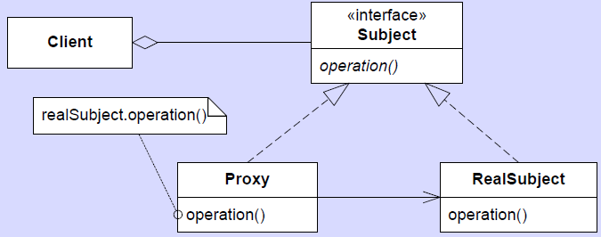
The Process
3 + 1: Already done:
2: Composition: The intermediate / ‘object-in-front’

Slide 7

Again, Visually
We use an intermediate object
Graph Program
Real StockPrice Object
Logging ON
Proxy Object

Slide 8
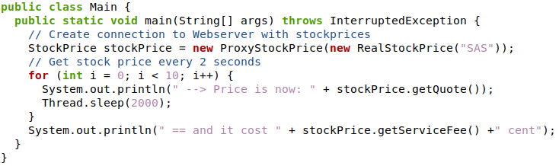
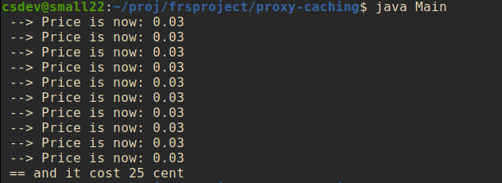
The New Design
10 calls, but only one expensive call!

Slide 9
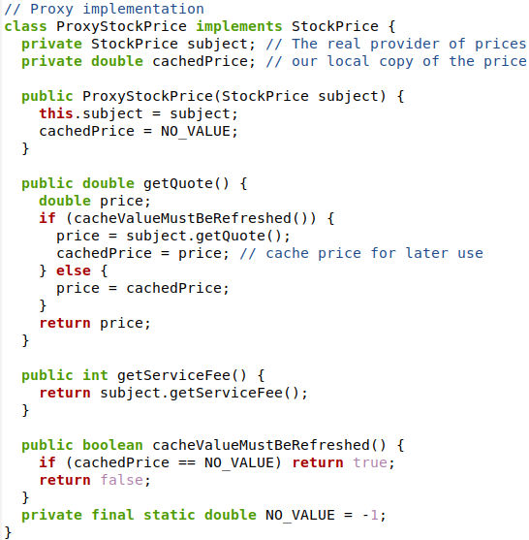
Proxy Code
Our Proxy Code
Note: This is an over-eager caching!
Normally cache should be ‘cold’ after N seconds

Slide 10
(Caching Liability)
A liability of caching (not of Proxy pattern in general) is that a local copy of course may be out-of-synch with the real value…
For some time, a wrong value is shown…
The real price has gone up, but we still use the cached value…

Slide 11

Case used in FRS
A web page contains a lot of images, many of which will never be displayed as they are ‘at the end of the scroll’ where the average user do not see at all. Can we avoid downloading them?
Same for a long Word document etc.
Loading from disk also takes time…
But we still need image size in order to lay out the page properly,
So some info needs to be fetched

Slide 12
Proxy
Download on demand – i.e. only download the “heavy stuff” = the raster image, when the image become visible
The point:
Load the “small data” immediately
Like image width and image height
Load the “large data” on demand
Like the graphics: PNG or JPEG data
Two step loading
i.load() (1); i.show() (2)

Slide 13
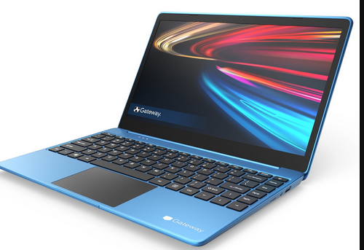

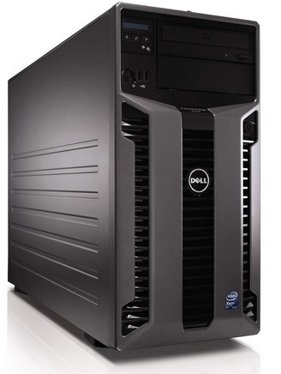
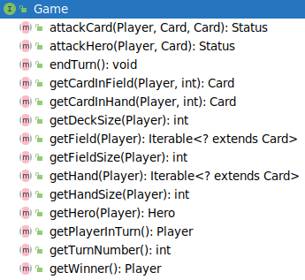
Another Case
Proxy Pattern is central in Distributed Computing
HotStone –
Bente and Arne plays a game
Bente on Bente’s computer
Arne on Arne’s computer
The game’s real state is on hotstone.littleworld.dk
Then, how does getCardInField() work on Bente’s Computer ?
The card state is not on Bente’s computer !!!

Slide 14
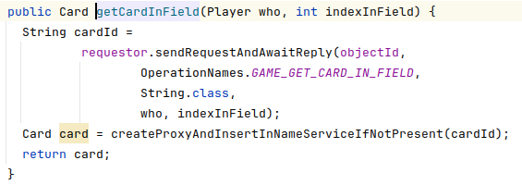
Proxy to the Rescue
Proxy is a surrogate/placeholder for another object
Note – no (permanent) data on the client, all accessor and mutators become “call server, get answer”
Send request to server for data on card (who, indexInField);
Await server responding with some data, for instance in JSON format;
Create a local ‘StandardCard’ with the values provided in that JSON format;
Return that card,

Slide 15
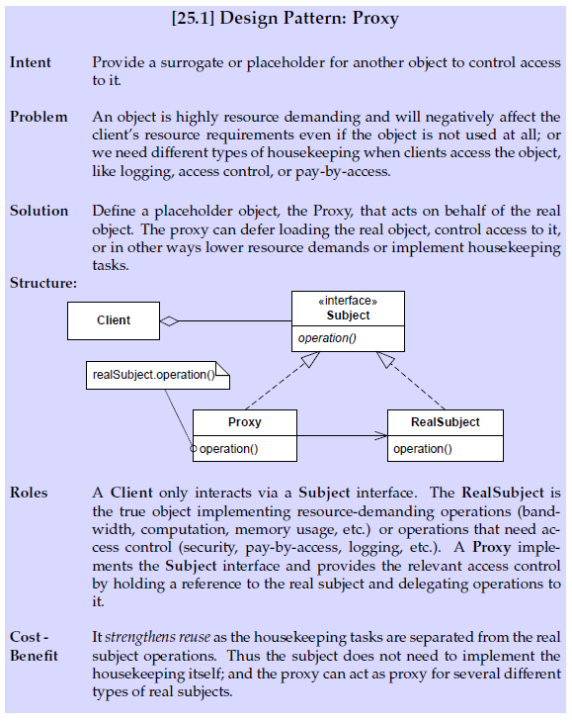
Proxy
Notes:
15

Slide 16
Consequences
And in SWEA Broker…
Benefits
Supports all types of access control: deferred access, pay-by-access, access logging (audit trail), access control, …
Decouples domain behavior and access control behavior (Different roles! Cohesion!)
Is the core technology in remote method invocation
Java RMI
.Net Remoting

Slide 17
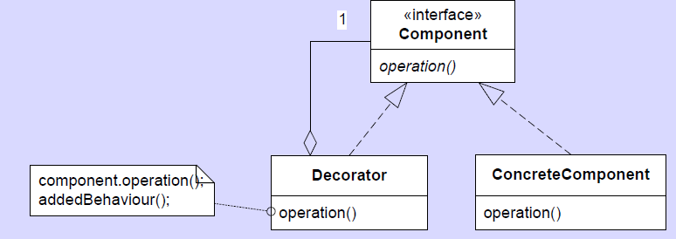
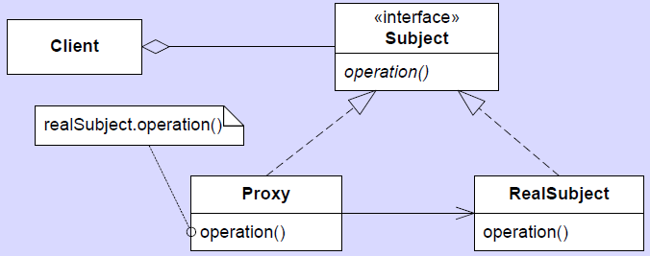
Decorator Versus Proxy
The look alike!
Indeed, the UML looks very similar
But they look at different things
Decorator looks at the object itself (looking inside)
Adding behaviour to the object itself
Proxy looks at the user of the object (looking outside)
Monitoring/controlling who is using the object

